Slide 1
Image Processing Internship
Transforming Plane Images into Fold Flags Using Python Techniques
Company name

Slide 2

Introduction
This presentation covers the process of transforming two plane images into a folded flag using image processing techniques implemented in Python.

Slide 3
01
Image Acquisition

Slide 4
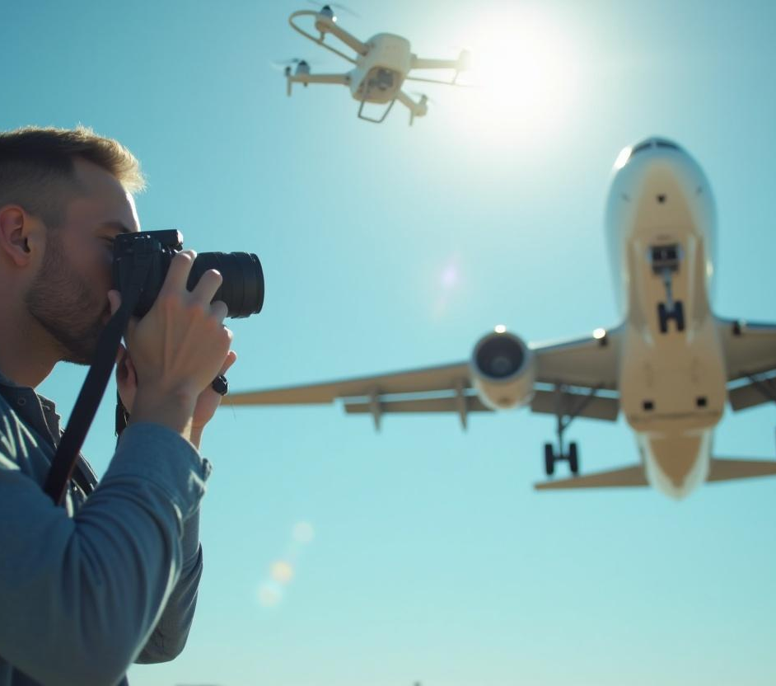
Capturing Plane Images
Capturing high-quality images of planes is essential for effective processing. Utilize professional cameras or drones equipped with high-resolution sensors to ensure that images are clear and detailed. The images should be taken under consistent lighting conditions to reduce noise and improve processing outcomes.

Slide 5
Image Quality Considerations
Image quality significantly impacts processing results. Ensure proper focus, color balance, and exposure in the captured images. Techniques such as noise reduction, sharpness enhancement, and resolution optimization should be employed to improve the image's usability for further processing steps.

Slide 6
Tools for Image Capture
For effective image capture, various tools can be employed. Recommended tools include DSLRs, mirrorless cameras, and professional drones which offer high-resolution imagery. Software like Adobe Lightroom can assist in managing and editing images to enhance clarity and consistency. It is crucial to select tools based on the project requirements and budget.

Slide 7
02
Image Processing Techniques

Slide 8
Image Transformation Methods
Image transformation methods are vital in converting plane images into a desired format. Techniques such as rotation, scaling, and perspective transformation can be utilized. These transformations adjust the dimensions and orientation of images to align with the intended folding patterns of the flag. Proper application of these methods ensures accuracy in the final output.

Slide 9
Flag Folding Algorithm Implementation
Implementing a flag folding algorithm involves coding in Python to manipulate the pixel data of the images. Using libraries such as OpenCV and NumPy, one can create algorithms that simulate the physical folding of a flag based on defined parameters. The algorithm must accurately interpret image structure to achieve a realistic fold appearance.

Slide 10

Testing and Validation of Results
Testing and validation are crucial steps in the image processing pipeline. After implementation, the folded flag images should be evaluated for quality against predefined metrics. This includes checking for visual fidelity, ensuring proper alignment, and confirming that the transformations have been executed correctly. Feedback from testing will allow for iterative improvements.

Slide 11

Conclusions
In conclusion, the transformation of plane images into a folded flag using Python requires careful planning and execution. The selection of appropriate tools, methodologies for image processing, and thorough validation processes are key to achieving successful outcomes. This presentation serves as a foundation for further exploration in image processing applications.

Slide 12
Thank you!
Do you have any questions?
+00 000 000 000
www.yourwebsite.com

